Slide 1
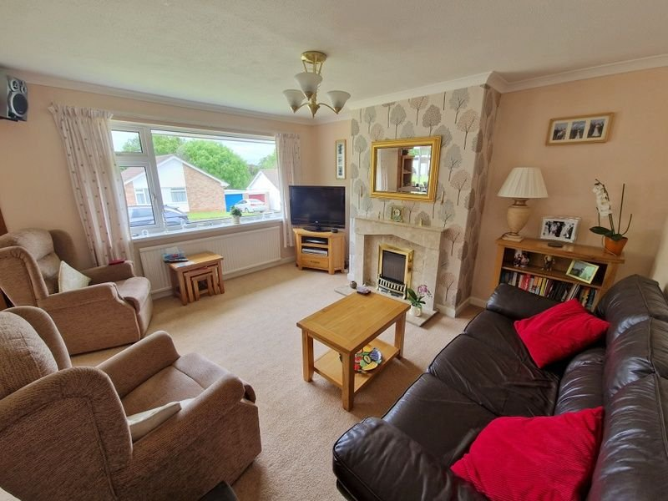
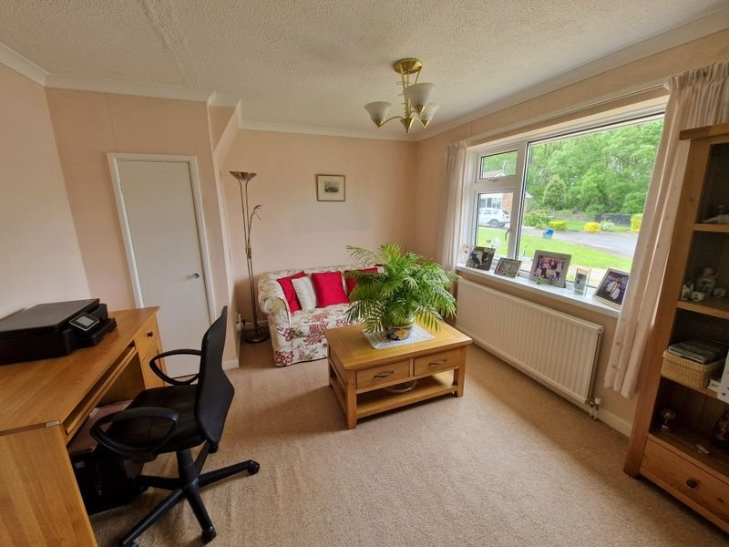
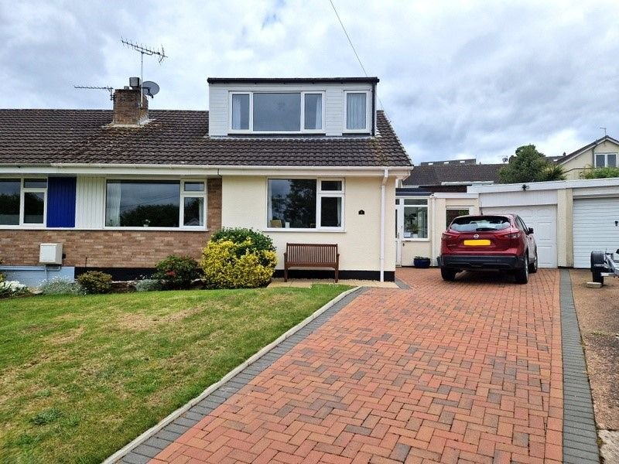
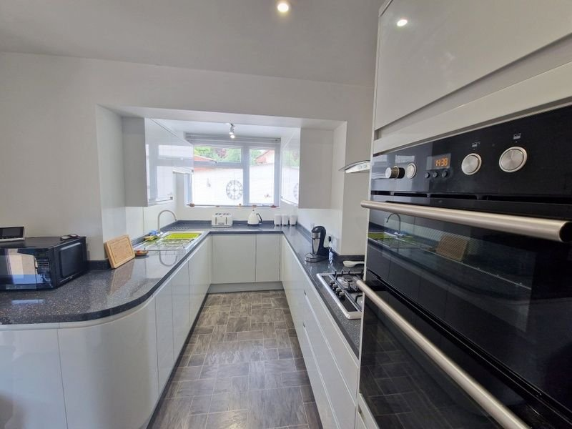
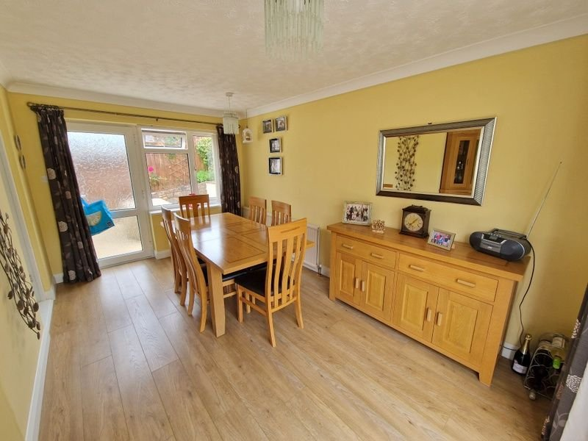
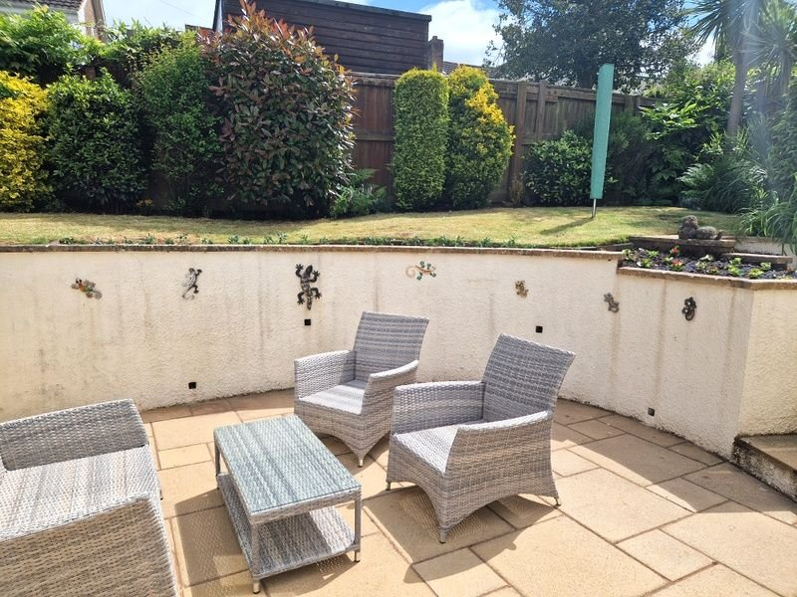
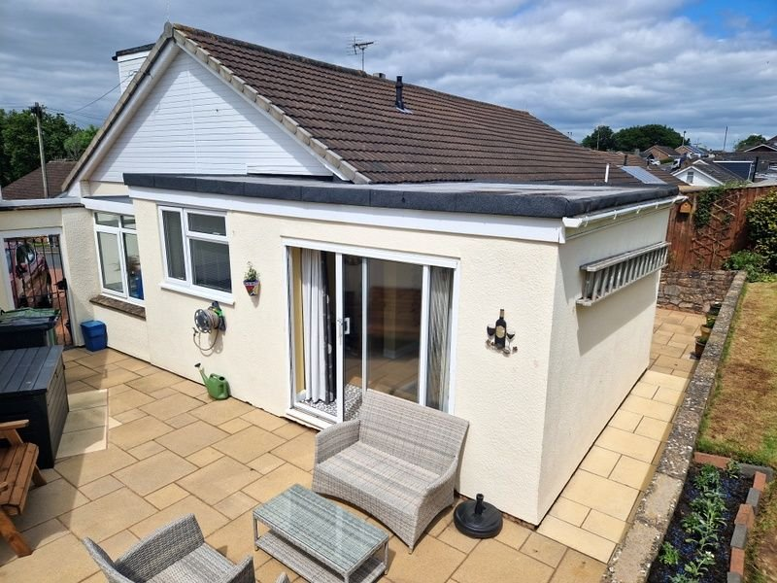
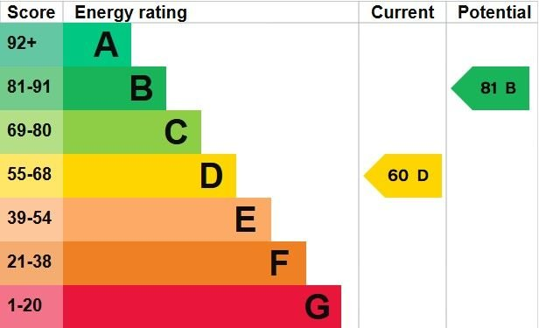
www.pennys.net
8 Chichester Close, Exmouth, EX8 2JU
GUIDE PRICE £385,000
TENURE Freehold
An Extended Semi Detached Chalet Style Bungalow With Ample Parking, Attractive Gardens And Garage Enjoying A Favoured Cul-De-Sac Location
Entrance Porch And Reception Hall * Lounge * Modern Fitted Kitchen With Built-In Appliances * Sitting Room/Bedroom Three * Dining Room * Ground Floor Bedroom * Modern Shower Room/WC * Spacious First Floor Bedroom Two * Gas Central Heating * Double Glazing * Viewing Recommended
Pennys Estate Agents Limited for themselves and for the vendor of this property whose agents they are give notice that:- (1) These particulars do not constitute any part of an offer or a contract. (2) All statements contained in these particulars are made without responsibility on the part of Pennys Estate Agents Limited. (3) None of the statements contained in these particulars are to be relied upon as a statement or representation of fact. (4) Any intending purchaser must satisfy himself/herself by inspection or otherwise as to the correctness of each of the statements contained in these particulars. (5) The vendor does not make or give and neither do Pennys Estate Agents Limited nor any person in their employment has any authority to make or give any representation or warranty whatever in relation to this property.
PENNYS ESTATE AGENTS
2 Rolle House, Rolle Street, Exmouth, Devon, EX8 2SN
Tel: 01395 264111 EMail: help@pennys.net

Slide 2
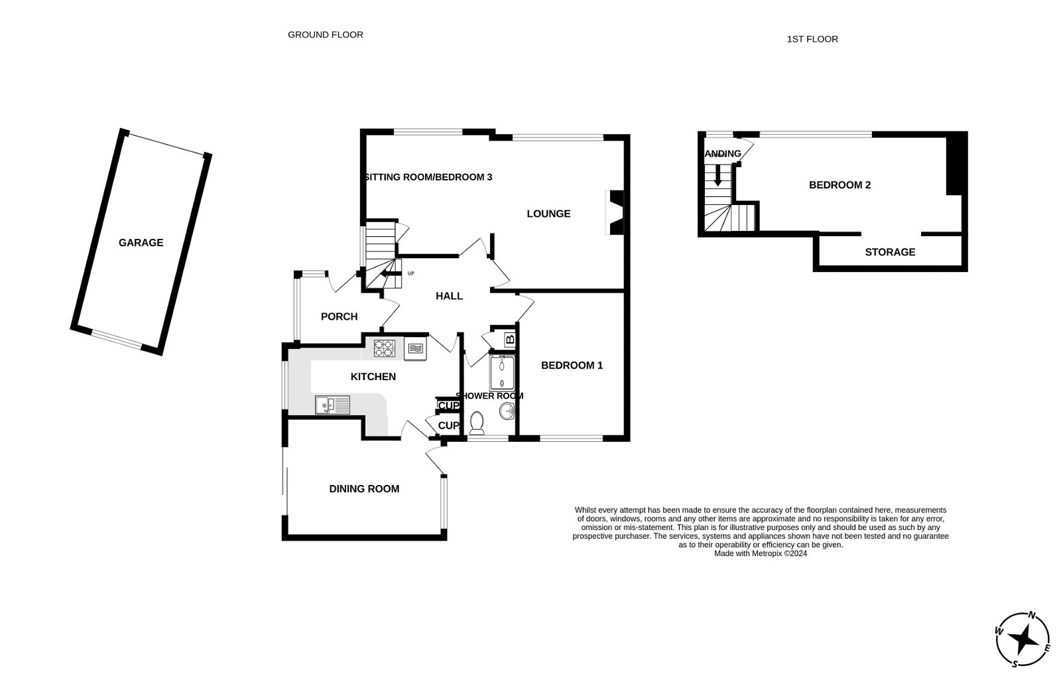
8 Chichester Close, Exmouth, EX8 2JU
THE ACCOMMODATION COMPRISES: Double glazed front door giving access to:
ENTRANCE PORCH: 2.62m x 1.83m (8'7" x 6'0") Useful entrance to the property with tiled floors, double glazed windows. Inner part glazed door giving access to:
RECEPTION HALL: With radiator, linen cupboard housing Worcester gas boiler, radiator, telephone point, open tread staircase rising to first floor.
LOUNGE/DINING ROOM: Lounge area: 4.14m x 3.66m (13'7" x 12'0") A bright room with double glazed window to front aspect, marble fire surround with matching hearth housing living flame effect gas fire, TV point, radiator. Opening with wood ceiling beam to:
SITTING ROOM/BEDROOM 3: 3.66m x 3.4m (12'0" x 11'2") (Also accessed from the reception hall). A versatile room that could provide a further bedroom if required by erecting a partition wall. Radiator, fitted cupboard and double glazed window to front aspect.
KITCHEN: 4.57m x 2.82m (15'0" x 9'3") narrowing to 6’5 (1.96m) A spacious stylish kitchen fitted with a range of gloss finish pattern work surfaces with matching splashbacks with range of cupboards and drawer units, integrated dishwasher and washing machine beneath worktops, matching range of wall mounted cupboards, inset four ring gas hob with glass splashback and chimney style extractor over, built-in double oven with cupboards over and drawer units beneath, space for upright fridge/freezer, pull out larder style cupboard, recessed LED ceiling spotlighting, radiator, double glazed window to side aspect.
DINING ROOM EXTENSION: 4.39m x 3.35m (14'5" x 11'0") With sliding double glazed patio doors to sun terrace and further double glazed door giving access to additional sun terrace area, double glazed windows, wood effect flooring overlooking the gardens, radiator.
GROUND FLOOR BEDROOM 1: 13’ 3 x 9’ 10 plus door recess. Double glazed window to rear elevation, radiator and TV point.
SHOWER ROOM/WC: 2.31m x 1.47m (7'7" x 4'10") Fitted with a modern suite comprising; double width shower cubicle with Mira shower unit and sliding shower splash screen doors, vanity wash hand basin, WC with concealed cistern and push button flush. Fitted wall mirror, chrome heated towel rail, fully tiled walls, double glazed window fitted with pattern glass, LED ceiling spotlighting, light extractor fan.
FIRST FLOOR LANDING AREA: With double glazed window and door to:
BEDROOM 2: 6.4m x 2.82m (21'0" x 9'3") into wall recesses. Spacious bedroom with part sloping ceiling, access to boarded loft void, built-in storage/cupboard area with curtain divider and power sockets. Radiator and double glazed window to front elevation.
OUTSIDE: Located towards the head of this favoured cul-de-sac, this property enjoys a long block paved driveway providing ample off road parking leading to the garage. Lawned area of front garden with patio sun terrace, decorative stone flower and shrub beds, outside lighting. A side gate gives access to the rear garden which is a lovely feature of the property enjoying two patio sun terrace areas ideal for outside entertaining, raised area of lawned garden edged with well stocked flower beds and borders. Outside light and outside tap.
GARAGE: 5.41m x 2.46m (17'9" x 8'1") Up and over door, power and light connected, double glazed window.
FLOOR PLAN:

